Slide 1
Angular 17
Lesson 2—Introduction to TypeScript

Slide 2


Introduction
In Angular 17, JavaScript is replaced by TypeScript (TS).
TypeScript 1.0 was released on April 2014, with ES6 alignment.

Slide 3

The need for TypeScript
The necessity for Nodemon in TypeScript
The usage of String Templates
The usage of var, let and const type
Knowledge of class and interface
Knowledge of class and interface
The usage of new collection types, maps, and sets

Slide 4
Introduction to TypeScript
Topic 1—The Need for TypeScript

Slide 5



What's Good With JavaScript?
It’s everywhere
Huge amount of Libraries
Flexible

Slide 6



What's Wrong With JavaScript?
Dynamic typing
Lack of modularity
Verbose patterns
(Immediately Invoked Function Expression (IIFE))
In short:
JavaScript development scales badly

Slide 7






Advantages of TS Over JS
Scalable HTML5 client-side development
Non-invasive (existing Libs, browser support)
Modular development
Long-term vision
Easy learning for Java Developer
Clean output

Slide 8
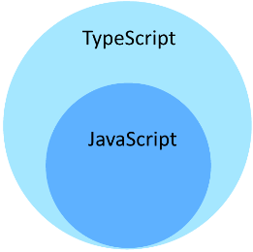



TypeScript Features
Superset of JavaScript
Compiles to ES3/ES5
Optionally typed
No special runtime
Example:
In short:
Lightweight productivity booster

Slide 9
Comparison Between ES5 vs. ES6
ES5 vs ES6
Language
ECMAScript (ES)
Dialect
(Follows ES)
JavaScript
ES6
ES6
Supported by all Browsers
Needs polyfills, transpilers

Slide 10

Start And End With JavaScript
Starts and ends with JavaScript
Strong tools for large apps
TypeScript starts from the same syntax and semantics that millions of JavaScript developers know today. Use existing JavaScript code, incorporate popular JavaScript libraries, and call TypeScript code from JavaScript.
TypeScript compiles to clean, simple JavaScript code which runs on any browser, in Node.js, or in any JavaScript engine that supports ECMAScript (or newer).
Types enable JavaScript developers to use highly-productive development tools and practices like static checking and code refactoring when developing JavaScript applications.
Types are optional, and type inference allows a few type annotations to make a big difference to the Static Verification of your code. Types let you define interfaces between software components and gain insights into the behavior of existing JavaScript libraries.

Slide 11
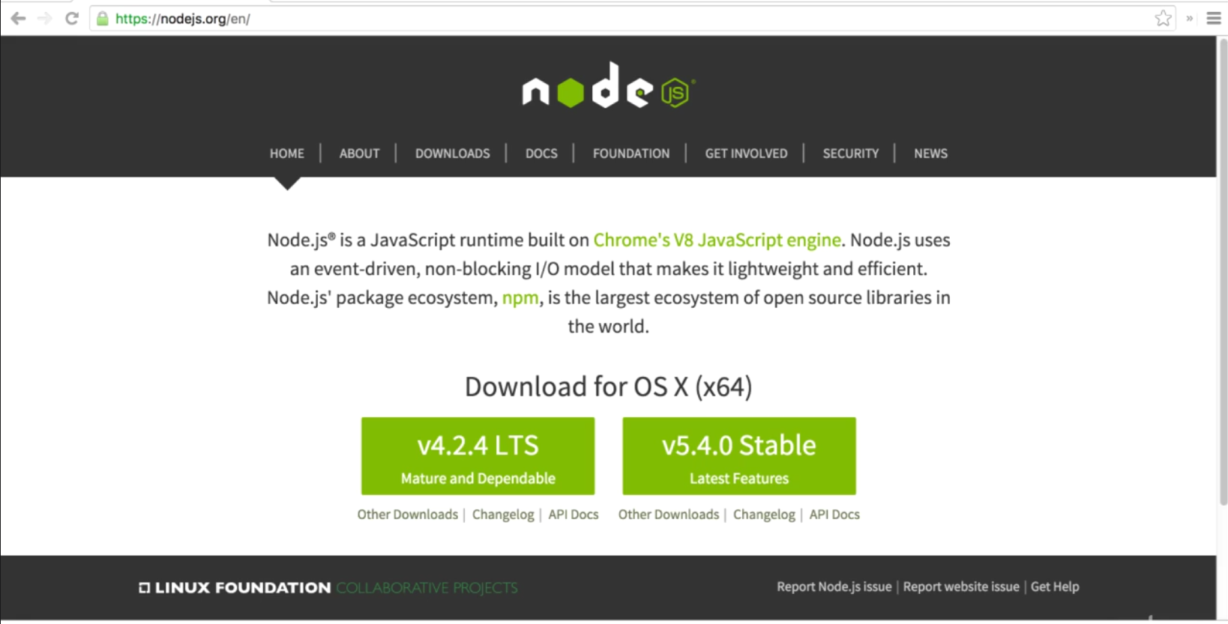
Setting up TypeScript
Download NODEJS

Slide 12
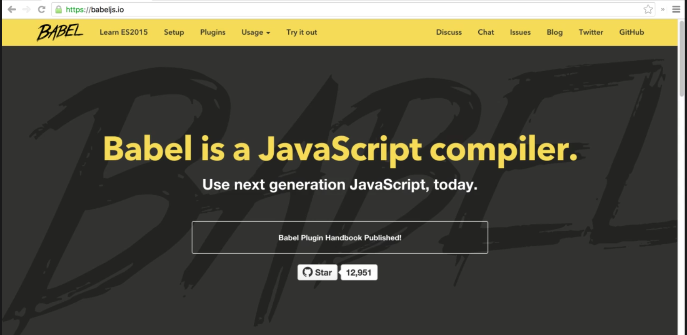
Setting up TypeScript—BABEL
Babel is a translator that is used for converting ES6 specific standard to ES5 standard.

Slide 13
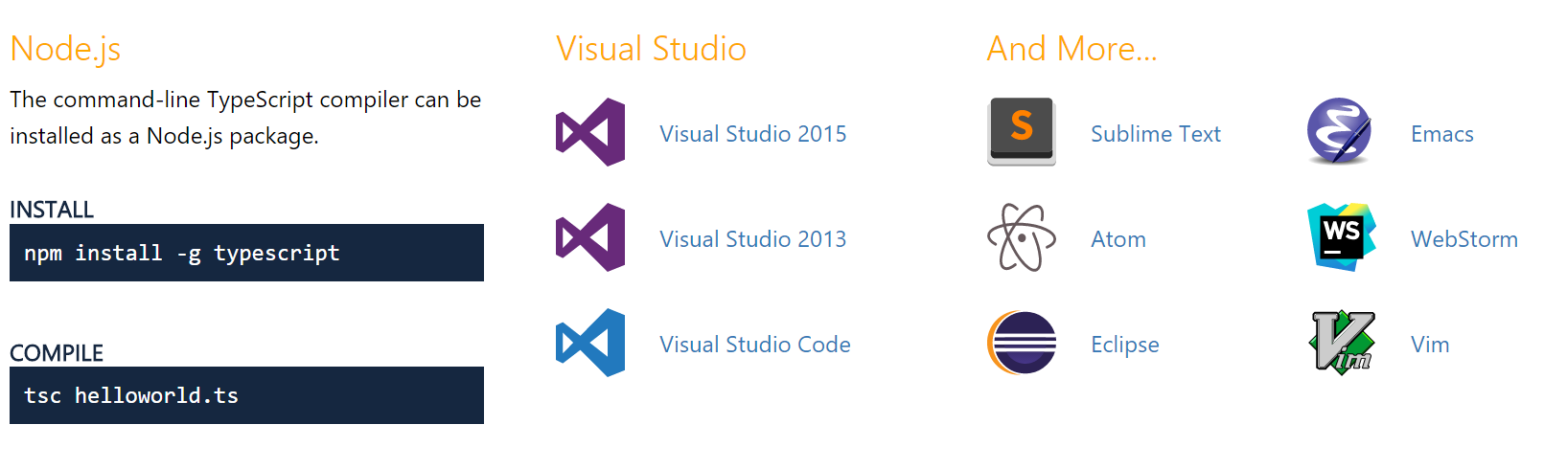
Getting TypeScript

Slide 14
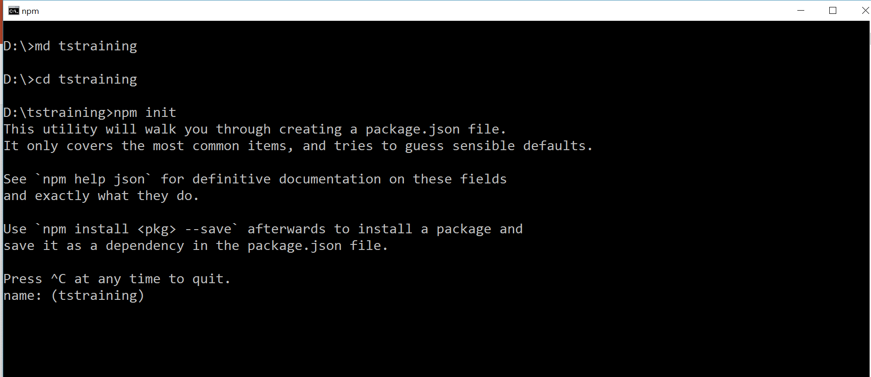
Setting up TypeScript
CREATE PACKAGE.JSON FILE
C:\>_
Command Prompt

Slide 15
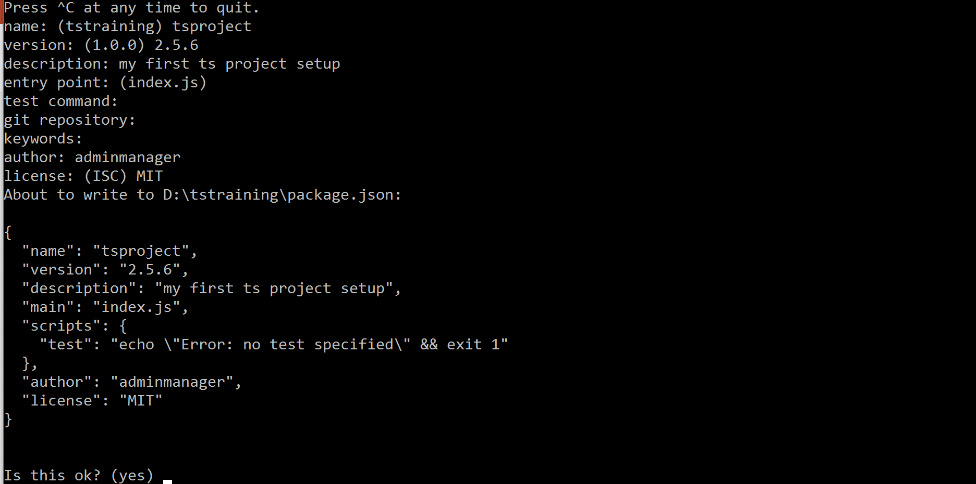
Setting up TypeScript (Contd.)
CREATE PACKAGE.JSON FILE
C:\>_
Command Prompt

Slide 16


Lab—Demo
START LAB

Slide 17
Introduction to TypeScript
Topic 2—Nodemon

Slide 18

Introduction to Nodemon
Nodemon is a utility that will monitor for any changes in your source and automatically restart your server. It is perfect for development. You can install it using npm.

Slide 19
Introduction to Nodemon (Contd.)
Just use Nodemon instead of node to run your code, and now your process will automatically restart when your code changes.
To install, get node.js., and then from your terminal run:
npm install -g nodemon

Slide 20











Features of Nodemon
Automatic restarting of application
Watches specific directories
Works with server applications or one time run utilities and Read-Eval-Print-Loop (REPLs)
Detects default file extension to monitor
Default support for node and CoffeeScript, but easy to run any executable (such as Python, Make, etc.)
Required in node apps
Ignores specific files or directories
Open source and available on GitHub

Slide 21
Lab—Demo
START LAB

Slide 22
Introduction to TypeScript
Topic 3—String Template

Slide 23


TypeScript Strings Template
TypeScript Template Strings bring a solution to the limitations of JavaScript strings.
Strings in JavaScript have been historically limited, lacking the capabilities one might expect coming from languages like Python or Ruby.

Slide 24
TypeScript Strings Template
Template Strings introduce a way to define strings with domain-specific languages (DSLs), bringing better:
String interpolation
1
2
Embedded Expressions
String tagging for safe HTML escaping, localization and more
5
3
Multiline Strings without hacks
4
String Formatting
Rather than stuffing yet another feature into Strings, as we know them today, Template Strings introduce a completely different way of solving these problems.

Slide 25
TypeScript Strings Template—Example
In TypeScript, as in JavaScript, string values are normally wrapped with double or single quotes.
>_
training@localhost:~
// TypeScript code
“This is a string value”
‘This is also a string value’
‘And so it this one, isn’t it?’
‘And so it this one, isn\’t it

Slide 26
TypeScript Strings Template
We can also use backtics to create string templates which will be rendered as they are.
>_
training@localhost:~
// TypeScript code
let myScript = ‘
Whose woods these are I think I know.
His house is in the village though;
He will not see me stopping here
To watch his woods fill up with snow.
Robert Frost’

Slide 27
TypeScript Strings Template—Example
String templates can contain placeholders for variable data as seen in the example:
>_
training@localhost:~
//Typescript code
let theName: string = prompt(“What is your name?”);
let greetings: string = ‘Hello ${theName}, I’m so happy to see you!’;
alert(greetings);
The data collected by the prompt is assigned to variable theName, which then is embedded in the ${ } template and displayed along with the data from variable greetings.

Slide 28
Lab—Demo
START LAB

Slide 29
Introduction to TypeScript
Topic 4—var, let, and const Keyword

Slide 30
var
var variables in JavaScript are function scoped.
This is different from many other languages (C# / Java etc.) where the variables are block scoped.
If you bring a block scoped mindset to JavaScript, you would expect the following to print 123. Instead, it will print 456.
>_
training@localhost:~
var foo = 123;
if (true) {
var foo = 456;
}
console.log(foo); //456

Slide 31
let Declaration
Developers introduced the let statements because there were problems with var statements. Apart from the keyword used, let statements are written the same way as var statements.
let hello = "Hello!";
The key difference is not in the syntax, but in the semantics.
Block scoping
When a variable is declared using let, it uses what some call lexical-scoping or block scoping.
Unlike variables declared with var, whose scopes leak out to their containing function, block-scoped variables are not visible outside of their nearest containing block or for-loop.

Slide 32
let Declaration—Example
The same example is demonstrated with let:
>_
training@localhost:~
let foo = 123;
if (true) {
let foo = 456;
}
console.log(foo); //123
Another place where let would save you from errors is loops:
>_
training@localhost:~
var index = 0;
var array = [1,2,3];
for (let index = 0; index < array.length; index++)
console.log(array[index]);
}
console.log(index); //0

Slide 33
Lab—Demo
START LAB

Slide 34
const Declaration
const is a welcome addition offered by ES6 / TypeScript. It allows you to be immutable with variables.
This is good from a documentation as well as a runtime perspective.
To use const, just replace var with const:
const foo = 123;
Using const is good for both readability and maintainability. It avoids using magic literals.
>_
training@localhost:~
// Low readability
if (x>10){
}
//Better!
const maxRows = 10;
if(x>maxRows) {
}

Slide 35
const Declaration (Contd.)
They are like let declarations, but as the name implies, their value cannot be changed once they are bound.
In other words, they have the same scoping rules as let, but you can’t reassign to them.
This should not be confused with the idea that the values they refer to are immutable.
A const is block scoped like the let declaration:
>_
training@localhost:~
const foo = 123;
if(true) {
const foo = 456; //Allowed as itsa new variable limited to this ‘if’ block
}

Slide 36
let vs. const
Applying the principle of least privilege, all declarations other than those you plan to modify should use const.
const
let
Using const also makes code more predictable when reasoning about flow of data.
On the other hand, let is shorter to write than var, and many users will prefer its brevity.

Slide 37
Lab—Demo
START LAB

Slide 38


Debugging TypeScript in Firefox or Chrome
Firefox and Chrome have built-in debuggers, so you can easily debug the generated JavaScript. However, if you want to develop in the language you have programmed (be it TypeScript, Dart, or CoffeeScript), you need another option.

Slide 39


Debugging TypeScript in Firefox or Chrome (Contd.)
Source Maps:
All major browsers support source maps now, but may require you to jump through a couple hoops. A source map is basically what it says—a map from one language to another. So the debugger can run the JavaScript code, but shows you the line that actually generated it.
First you need to tell Visual Studio to generate a source map for your TypeScript project. Right click your Project file in Solution Explorer and select Properties.

Slide 40
Lab—Demo
START LAB

Slide 41
Rest Parameter
The rest parameter syntax allows you to represent an indefinite number of arguments as an array.
Rest parameters (denoted by ... argumentName for the last argument) allow you to quickly accept multiple arguments in your function and get them as an array.
Rest Parameters
Required, optional, and default parameters all have one thing in common: they talk about one parameter at a time.
Sometimes, you want to work with multiple parameters as a group, or you may not know how many parameters a function will ultimately take.
In JavaScript, you can work with the arguments directly using the arguments variable that is visible inside every function body.

Slide 42
Examples for Rest Parameter and Without Rest Parameter
>_
training@localhost:~
function foo(x:number, y:number, z:number){
console.log(x,y,z);
}
var args:number[,] = [0,1,2];
(<any>foo)(…args);
This results in the same apply function call, that you'd expect:
>_
training@localhost:~
function foo(x, y, z){
console.log(x,y,z);
}
var args = [0,1,2];
foo.apply(void 0, args);
>_
training@localhost:~
function foo(…x: number[]){
console.log(JSON.stringify(x));
}
var args:number[] = [0,1,2];
foo(…args);
With Rest Parameter:

Slide 43
Spread Operator
The spread operator is the opposite of destructuring. It allows you to spread an array into another array, or an object into another object. For example:
>_
training@localhost:~
let first = [1,2];
let second = [3,4]
let bothPlus = [0, ...first, ...second, 5];
This gives bothPlus the value [0, 1, 2, 3, 4, 5]. Spreading creates a shallow copy of first and second. The values are not changed by the spread.
You can also spread objects:
>_
training@localhost:~
let defaults = {food: “spicy”, price: “$$”, ambiance: “noisy”};
let search = {...defaults, food: “rich”};

Slide 44
Lab—Demo
START LAB

Slide 45
Arrow Functions
Described as the fat arrow (because -> is a thin arrow and => is a fat arrow) and also called a lambda function (because of other languages).
()=>{}
Another commonly used feature is the fat arrow function ()=>something.
The advantage of a fat arrow is:
You don't need to keep typing function
It lexically captures the meaning of this
It lexically captures the meaning of arguments
For a language that claims to be functional, in JavaScript you tend to be typing function quite a lot. The fat arrow makes it simple for you to create a function
var inc = (x)=>x+1;

Slide 46
this Loop
“this” has traditionally been a pain point in JavaScript. Fat arrows fix it by capturing the meaning of this loop from the surrounding context.
>_
training@localhost:~
function Person(age) {
this.age = age;
this.growOld = () => {
this.age++;
}
var person = new Person(1);
setTimeout(person.growOld,1000);
setTimeout(function() { console.log(person.age);}, 2000); //2

Slide 47
Lab—Demo
START LAB

Slide 48
for…of
A common error experienced by JavaScript developers is that for...in for an array does not iterate over the array items.
Instead, it iterates over the keys of the object passed in.
This is demonstrated in the example. Here you would expect 9,2,5, but you get the indexes 0,1,2:
>_
training@localhost:~
var someArray = [9,2,5];
for (var item in someArray) {
console.log(item); //0,1,2
}
This is one of the reasons why for...of exists in TypeScript (and ES6). The following iterates over the array correctly logging out the members as expected:
>_
training@localhost:~
var someArray = [9,2,5];
for (var item of someArray) {
console.log(item); //9,2,5
}

Slide 49
Lab—Demo
START LAB

Slide 50
Introduction to TypeScript
Topic 5 — Class Interfaces

Slide 51
Introduction to Classes
Traditional JavaScript uses functions and prototype-based inheritance to build up reusable components. But this may feel a bit awkward to programmers who are more comfortable with an object-oriented approach, where classes inherit functionality and objects are built from these classes.
Starting with ECMAScript 2015, also known as ECMAScript 6, JavaScript programmers will be able to build their applications using this object-oriented class-based approach.
In TypeScript, developers use these techniques now, and compile them down to JavaScript that works across all major browsers and platforms, without having to wait for the next version of JavaScript.

Slide 52
Importance of Classes
The reason why it's important to have classes in JavaScript as a first class item is that:
Classes offer a useful structural abstraction.
Provides a consistent way for developers to use classes instead of every framework (emberjs, reactjs etc.) coming up with their own version.
Object Oriented developers already understand classes.
Finally, JavaScript developers can have class. Here, there is a basic class called Point.

Slide 53
Classes
>_
training@localhost:~
class Point {
x: number;
y: number;
constructor(x:number, y:number) {
this.x = x;
this.y = y;
}
add(point: Point){
return new Point(this.x + point.x, this.y + point.y);
}
}
var p1 = new Point(0,10);
var p2 = new Point(10,20);
var p3 = p1.add(p2); // {x:10,y:30}

Slide 54
Lab—Demo
START LAB

Slide 55
Interfaces
One of TypeScript’s core principles is that type-checking focuses on the shape that values have.
This is sometimes called “duck typing” or “structural subtyping.”
In TypeScript, interfaces fill the role of naming these types and are used as a powerful way of defining contracts within your code as well as contracts with code outside of your project.
Interfaces have zero runtime JS impact. There is a lot of power in TypeScript interfaces to declare the structure of variables.

Slide 56
Interfaces
The two samples are equivalent declarations, the first uses an inline annotation, the second uses an interface.
>_
training@localhost:~
// Sample A
declare var myPoint: {x: number; y: number;};
// Sample B
interface Point {
x: number; y:number;
}
declare var myPoint: Point;
However, the advantage of Sample B is that if someone authors a library that builds on the myPoint library to add new members, they can easily add to the existing declaration of myPoint.

Slide 57
Classes Can Implement Interfaces
If you want to use classes that must follow an object structure that someone declared for you in an interface, you can use the implements keyword to ensure compatibility.
>_
training@localhost:~
interface Point{
x: number; y: number;
}
class MyPoint implements Point{
x: number; y: number; //Same as Point
}

Slide 58
Lab—Demo
START LAB

Slide 59
Introduction to Generics
A major part of software engineering is building components that not only have well-defined and consistent APIs but are also reusable.
Components that are capable of working on the data of today as well as the data of tomorrow will give you the most flexible capabilities for building up large software systems.
In languages like C# and Java, one of the main tools in the toolbox for creating reusable components is generics, that is, being able to create a component that can work over a variety of types rather than a single one.
This allows users to consume these components and use their own types.

Slide 60
Introduction to Generics
The key motivation for generics is to provide meaningful type constraints between members. The members can be:
class instance members
class methods
function arguments
function return value

Slide 61
Generics
>_
training@localhost:~
class QueueNumber {
private data = [];
push = (item:number) => this.data.push(item);
pop = (): number => this.data.shift();
}
const queue = new QueueNumber();
queue.push(0);
queue.push(“1”); //ERROR : cannot push a string. Only numbers allowed
// ^ if that is fixed the rest would be fine too

Slide 62
Lab—Demo
START LAB

Slide 63
Introduction to TypeScript
Topic 6—Object Destructuring

Slide 64

Introduction to Object Literal
ECMAScript 6 makes declaring object literals even more succinct by providing shorthand syntax for initializing properties from variables and defining function methods.
It also enables the ability to have computed property keys in an object literal definition.
The object literal may very well be one of the best and the most popular features in JavaScript.
It’s a superset of JSON, which has now become the de facto standard for data transport on the web, quickly replacing XML.
The great thing about object literals is that they make it easy to assemble an arbitrarily nested and dynamic data object with a definition syntax that is human-readable because it’s so succinct.

Slide 65
Lab—Demo
START LAB

Slide 66
Demo
>_
training@localhost:~
var age = 25;
function printHello () {
console.log("Hello");
}
var person = {
name: 'Admin',
age,
printHello,
['hello' + (age + 2)]: 'I am here',
printAge () {
console.log(this.age);
}
};
// console.log(person.hello27);
person.printAge();

Slide 67
Introduction to Destructuring
TypeScript supports the following forms of Destructuring (literally named after de-structuring, that is, breaking up the structure):
Object Destructuring
Array Destructuring
It is easy to think of destructuring as an inverse of structuring. The method of structuring in JavaScript is the object literal.
>_
training@localhost:~
Var foo = {
bar: {
bas: 123
}
};

Slide 68
Object Destructuring
Destructuring is useful because it allows you to do in a single line, what would otherwise require multiple lines. Consider the following case:
>_
training@localhost:~
var rect = {x:0, y:10, width:15, height:20};
//Destructuring assignment
var {x,y,width,height} = rect;
console.log(x,y,width,height); //0,10,15,20

Slide 69
Array Destructuring
A common programming question: "How to swap two variables without using a third one?"
The TypeScript solution:
>_
training@localhost:~
var x = 1, y = 2;
[x, y] = [y, x];
console.log(x, y); // 2,1
Array Destructuring with rest:
>_
training@localhost:~
var [x, y, ...remaining] = [1, 2, 3, 4];
console.log(x, y, remaining); //1, 2, [3,4]

Slide 70
Lab—Demo
START LAB

Slide 71
Introduction to TypeScript Module System
Modules provide the possibility to group related logic, encapsulate it, structure your code, and prevent pollution of the global namespace.
Modules can provide functionality that is only visible inside the module, and they can provide functionality that is visible from the outside using the export keyword.
Modules are declarative; the relationships between modules are specified in terms of imports and exports at the file level.
In TypeScript, just as in ECMAScript 2015, any file containing a top-level import or export is considered a module.

Slide 72
Exporting a Declaration
Any declaration (such as a variable, function, class, type alias, or interface) can be exported by adding the export keyword.
>_
training@localhost:~
export interface StringValidator {
isAcceptable(s: string) : Boolean;
}
>_
training@localhost:~
export const numberRegexp = /^ [0-9] +$/;
export class ZipCodeValidator implements StringValidator {
isAcceptable(s: string) {
return s.length === 5 && numberRegexp.test (s);
}
}

Slide 73
Lab—Demo
START LAB

Slide 74
Introduction to TypeScript
Topic 7—Maps and Sets

Slide 75
Map
JavaScript has always had a very spartan standard library. But, a data structure for mapping values to values is not available.
The best you can get in ECMAScript 5 is a map from strings to arbitrary values, by abusing objects. Even then there are several pitfalls that can trip you up.
The Map data structure in ECMAScript 6 lets you use arbitrary values as keys.

Slide 76
Basic Operations
Working with single entries:
>_
training@localhost:~
> let map = new Map();
> map.set(‘foo’, 123);
> map.get(‘foo’)
123
> map.has(‘foo’)
true
> map.delete(‘foo’)
true
> map.has(‘foo’)
false

Slide 77
Set
ECMAScript 5 doesn’t have a set data structure, either. There are two possible work-arounds:
Use the keys of an object to store the elements of a set of strings.
Store (arbitrary) set elements in an array: Check whether it contains an element via indexOf(), remove elements via filter(), etc.
This is not a very fast solution, but it’s easy to implement. One issue to be aware of is that indexOf() can’t find the value NaN.
ECMAScript 6 has the data structure Set, which works for arbitrary values, is fast and handles NaN correctly.

Slide 78
Set (Contd.)
ECMAScript 6 has the data structure Set which works for arbitrary values, is fast, and handles NaN correctly.
Use the keys of an object to store the elements of a set of strings.
01
Set
This is not a very fast solution, but it’s easy to implement. One issue to be aware of is that indexOf() can’t find the value NaN.
04
Store (arbitrary) set elements in an array:
Check whether it contains an element via indexOf(), remove elements via filter(), etc.

Slide 79
Setting up a Set
You can set up a set via an iterable over the elements that make up the set. For example, via an array:
let set = new Set(['red', 'green', 'blue']);
Alternatively, the add method is chainable:
let set = new Set().add('red').add('green').add('blue');
>_
training@localhost:~
> let set = new Set();
> set.add (‘red’)
> set.has(‘red)
true
> set.delete(‘red’)
true
> set.has(‘red’)
true

Slide 80
Lab—Demo
START LAB

Slide 81
Typescript is ES-6 implementation, optionally typed, and a Superset of JavaScript.
Nodemon is a utility that will monitor for any changes in your source and automatically restart your server.
Strings Template introduce a completely different way of solving these problems.
let is block-scoped variables and are not visible outside of their nearest containing block or for-loop. const allows you to be immutable with variables.
Classes offer a useful structural abstraction. Interfaces fill the role of naming these types, and are used as a powerful way of defining contracts within your code as well as contracts with code outside of your project.
Set uses the keys of an object to store the elements of a set of strings.
The Map and data structure in ECMAScript 6 lets you use arbitrary values as keys.

Slide 83
Which is NOT true about TypeScript?
1
It is interpreted like JavaScript
It is a superset of JavaScript
It does support static data types
TypeScript is case sensitive

Slide 84
Which is NOT true about TypeScript?
1
It is interpreted like JavaScript
It is a superset of JavaScript
It does support static data types
TypeScript is case sensitive
a.
TS translate into JS using the interpreter by Babel or TSC.

Slide 85
What will be output of :
var a:string=47; console.log(“Value of a= ”+a);
2
Value of a=47
Value of a=0
Value of a=
None of the above

Slide 86
What will be output of :
var a:string=47; console.log(“Value of a= ”+a);
2
Value of a=47
Value of a=0
Value of a=
.
None of the above
d.
There is an error in line 1 of the code.

Slide 87
class Bird {
Bird () { console.log(“I am Bird”); }}
What will be output of : var obj=new Bird();?
3
Error
I am Bird
Bird am I
None of the above

Slide 88
class Bird {
Bird () { console.log(“I am Bird”); }}
What will be output of : var obj=new Bird();?
3
Error
I am Bird
Bird am I
None of the above
d.
Constructor keyword is used to built constructor and not a function with same name as class.

Slide 89
Output of: class MyClass {
var a=12; }
var obj=new MyClass(); console.log(“Value of a= ”+a);
4
Error
Value of a =12
A is private and cannot be accessed
None of the above

Slide 90
Output of: class MyClass {
var a=12; }
var obj=new MyClass(); console.log(“Value of a= ”+a);
4
Error
Value of a =12
A is private and cannot be accessed
None of the above
a.
var cannot be used inside class.

Slide 91
Program that converts a code from one high level language to another high level language is called_____.
5
Compiler
Decompiler
Inter translator
None of the above

Slide 92
Program that converts a code from one high level language to another high level language is called_____.
5
Compiler
Decompiler
Inter translator
None of the above
d.
Program that converts a code from one high level language to another high level language is called Transpiler.

